Slide 1
THE HUMAN FREEDOM INDEX 2018
A GLOBAL MEASUREMENT OF PERSONAL, CIVIL AND ECONOMIC FREEDOM

Slide 2
Context
The Human Freedom Index presents a broad measure of human freedom, understood as the absence of coercive constraint. It uses 79 distinct indicators of personal and economic freedom in the following areas:-
Personal Freedom
Rule of Law
Security and Safety
Movement
Religion
Association, Assembly, and Civil Society
Expression and Information
Identity and Relationships
Economic Freedom
Size of Government
Legal System and Property Rights
Access to Sound Money
Freedom to Trade Internationally
Regulation of Credit, Labor, and Business
The HFI is the most comprehensive freedom index so far created for a globally meaningful set of countries. The HFI covers 162 countries for 2016, the most recent year for which sufficient data are available and it includes three countries -Belarus, Iraq, and Sudan- that were added this year. The index ranks countries beginning in 2008, the earliest year for which a robust enough index could be produced.

Slide 3
Dataset
The pre-processed raw dataset file comprised of 1458 rows and 123 columns with 12.1% of missing data.
Processing of the file consisted of the following steps:
dropping rows where hf_score had null values since no data was available or could be replaced for analysis
dropping multiple columns since the data from these were derived into other columns
replacing null values with mean values especially since there were extreme values involved
After processing, the file comprised of 1378 rows and 27 columns with 0% missing data.

Slide 4
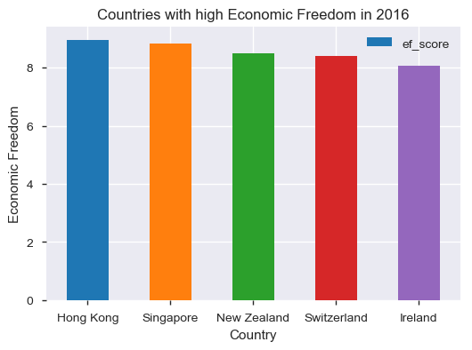
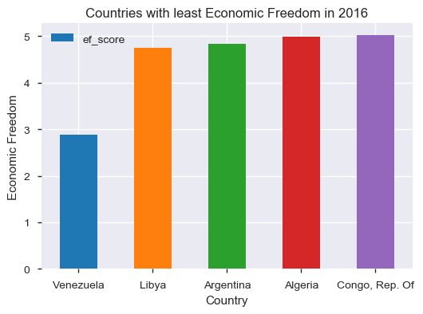
Economic Freedom (2016)

Slide 5
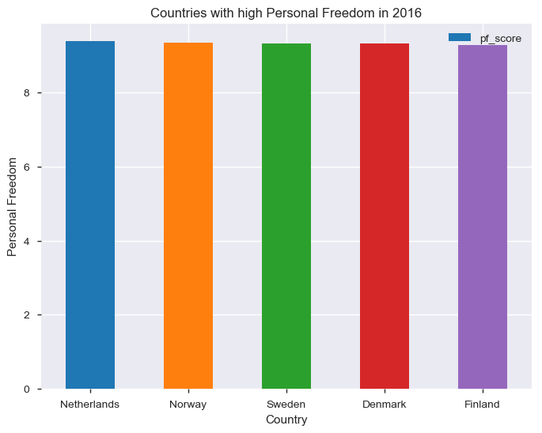
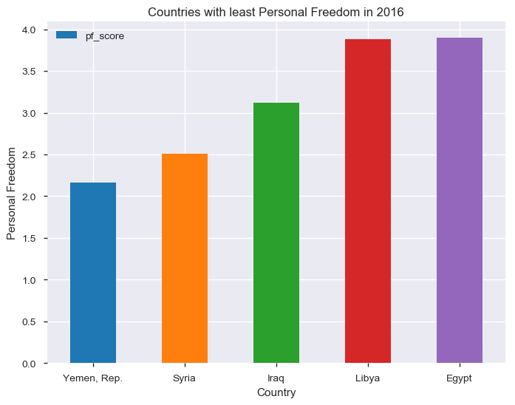
Personal Freedom (2016)

Slide 6
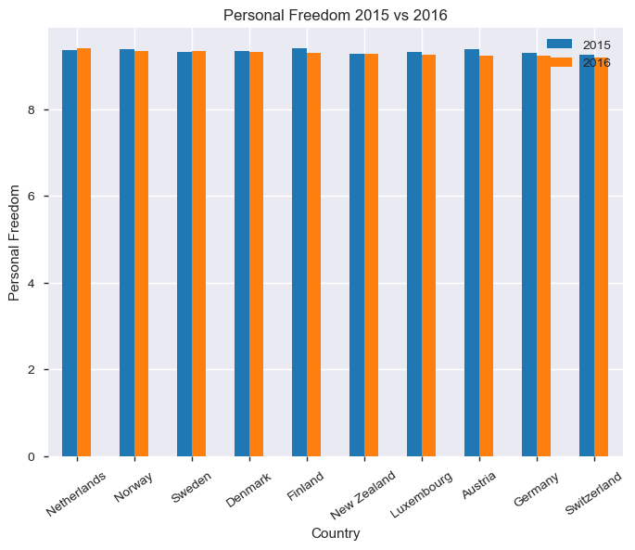
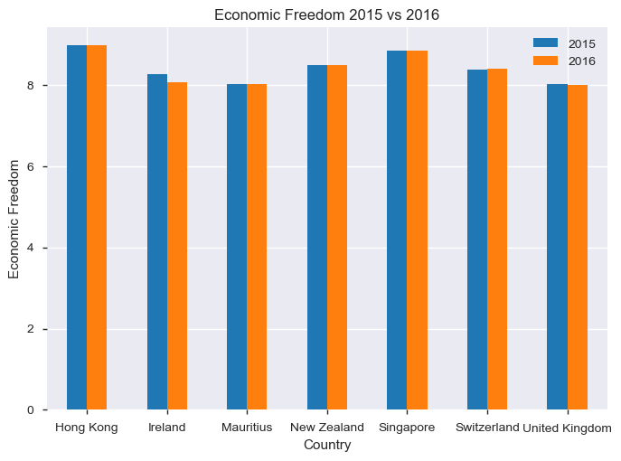
Economic & Personal Freedom (2015 vs 2016)

Slide 7
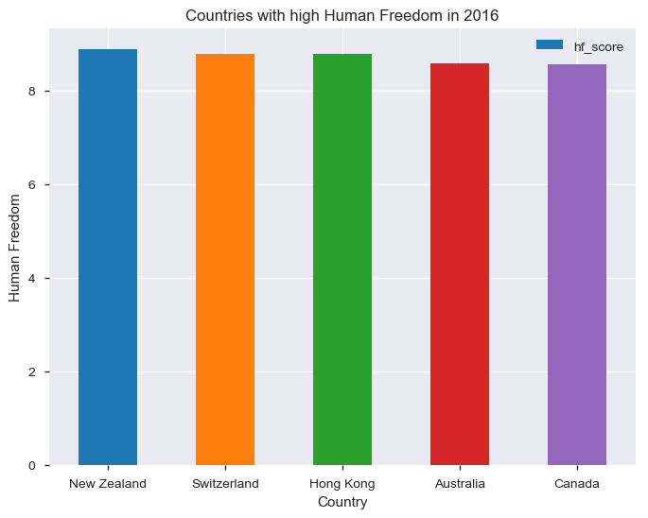
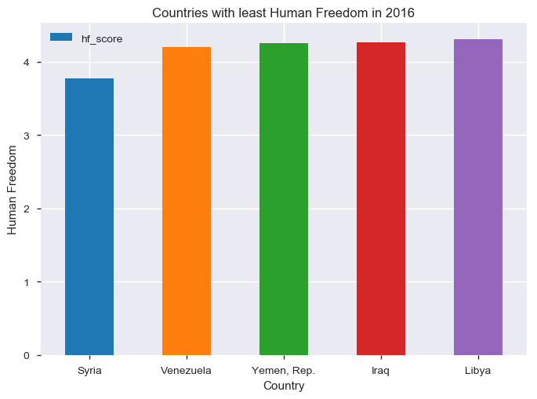
Human Freedom

Slide 8
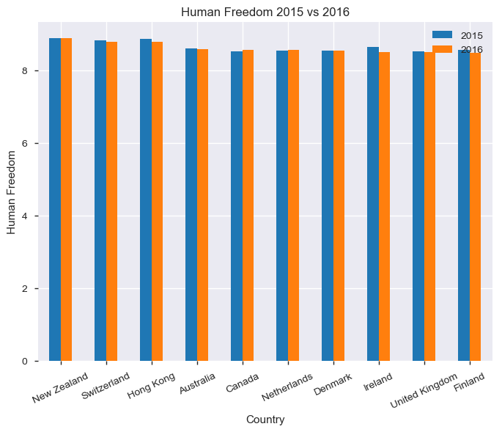
Human Freedom (2015 vs 2016)
New Zealand, Hong Kong, Canada, Netherlands and Denmark showed increase in Human Freedom score for 2016 compared to 2015.

Slide 9
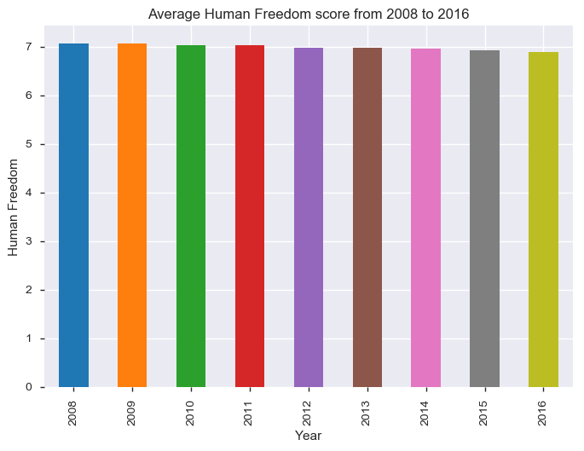
Human Freedom (2008 - 2016)
Human Freedom has decreased along the years from 7.07 in 2008 to 6.89 in 2016.

Slide 10
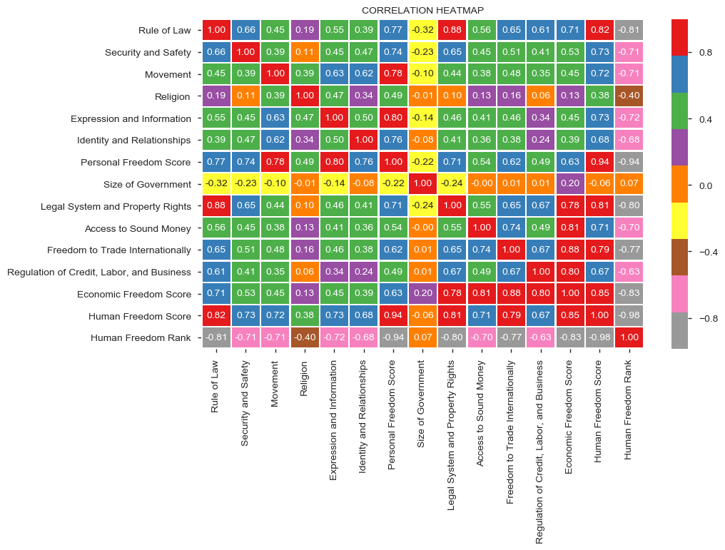
Human Freedom Heatmap
Values in grey are highly negatively correlated while the ones in red are highly positively correlated
Values in orange have little or no correlation
Factors that are not impacted by size of government: Money, Trade and Regulation
Factors that do not impact Human Freedom score: Government size
Factors that strongly impact Human Freedom score: Rule of Law, Legal, Freedom to Trade
Factors that mildly impact Human Freedom score: Religion
Economic Freedom is impacted strongly by: Legal, Sound Money, Trade and Regulations
Personal Freedom is impacted by: Freedom of Movement, Expression and Information

Slide 11
Conclusion
New Zealand, Switzerland, Hong Kong, Australia and Canada are the top 5 countries as per the 2016 data who have the highest level of Human Freedom.
Economic Freedom is impacted: Legal, Sound Money, Trade and Regulations
Personal Freedom is impacted by: Freedom of Movement, Expression and Information
The factors that impact Human Freedom directly are Rule of Law, Legal System and Property Rights and Freedom to Trade Internationally to a greater extent.

